Slide 1
GRAB ALL (RUNTIME ADVERTIZER APPLICATION)
BY-
Areeb Akhtar(01)
Shubham Patil(16)
Himanshu Wadekar(69)

Slide 2
PROBLEM STATEMENT
Lots of local vendors/ shopkeepers are suffering losses due to various online websites. The main constraint is that, the people are not aware about the offers on the desired products and their prices. Also, they are unaware about the places where they could get the product. Also, there is no such online platform to connect local vendors with people.

Slide 3
ABSTRACT
The motivation for every location based information system is: “To assist with the exact information, at right place in real time with personalized setup and location sensitiveness”. In this era we are dealing with palmtops and Android, which are going to replace the bulky desktops even for computational purposes. We have vast number of applications and usage where a person sitting in a roadside café needs to get relevant data and information. Such needs can only be catered with the help of LBS. A very appealing application includes surveillance where instant information is needed to decide if the people being monitored are any real threat or an erroneous target. We need to Import them on mobile devices. We must ensure that a person when visiting places need not carry the travel guides with him. All the information must be available in his mobile device and also in user customized format.

Slide 4
INTRODUCTION
Lots of local vendors/ shopkeepers are suffering losses due to various online websites. The main constraint is that, the people are not aware about the offers on the desired products and their prices. Also, they are unaware about the places where they could get the product. Also, there is no such online platform to connect local vendors with people. To solve this problem, we use location-based services. LBS can be characterized as "A remote IP administration that utilizes geographic data to serve a versatile client, any application administration that misuses the situation of a portable terminal." In mobile data services Location Based Services (LBS) is emerging as an important technology due to quick growth in wireless communication and location positioning technologies. Depending on the location of the mobile, Location Based Services (LBS) deliver information which plays a key role in this mobile information era. The LBS services has wide range of applications, such as health, entertainment, personal life, work, etc. It is also used to find out the persons or objects location, such as discovering about a restaurant or a grocery shop or a mall. LBS have two major actions, that is: Obtaining users location Provide a service by utilizing this information. The above actions can be used to obtain information such as:
1. Where the user is?
2. Where is the nearest place?
3. How to reach the nearest place?

Slide 5
LBS HAVE 2 MAJOR ACTIONS
1. Obtaining the location of user
2. Utilizing this information to provide a service.
These 2 actions are used to answer these 4 questions (below) for a mobile user in a new, fast, and
more accurate way, to form the basis for LBS:
Where am I…?
Where is the nearest ...?.
Where is my ...?,
How do I get there?

Slide 6
CHALLENGES
Challenges in Determining User Location
Accurate coordinates of location sources
User movement
Varying accuracy

Slide 7
FUNCTION
Location Tracking
This component stores the location trace of individual users. This represents a fundamental component in next-generation LBS as it contains the data that allows a user’s route to be determined and potentially predicted. In particular, this component would typically support the following functionality:
Keep records on user’s current location.
Notify the user when a specific offer is detected, or when the user moves in or out of an area.
This supports location-based notifications being sent to users.
Determine which offers are within a defined location.

Slide 8
SCOPE OF PROJECT
In our application, we have used Map Views as supported by Google APIs 10 or higher which would allow the use of app in devices starting from Gingerbread itself. We have used an .net Server with visual studio & MSSQL support for remote database use. The data transaction from or to the database occurs with the help of JavaScript and in the form of XML objects. The android end of the app handles this XML objects through HTTP clients. Onboard compass & map controllers are enabled. Locations are extracted from the device with the help of the GPS module available. A form of passive GPS use, the device decides on the best content with the information available from different providers. On touching the overlay on the map, options are asked ranging from extracting address to locating any other user on the same view.
The main objective is to detect the offers in the range set.

Slide 9
SYSTEM DIAGRAM
Backend
Webserver
Application
Database
Web Services

Slide 10
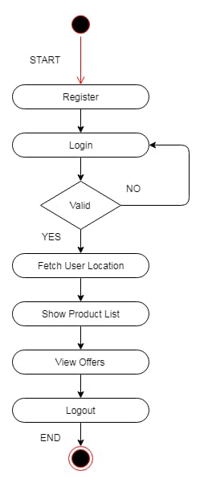
FLOWCHART

Slide 11
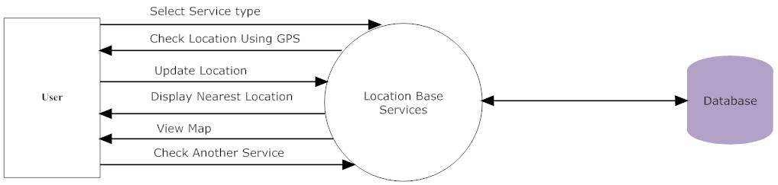
CLIENT SIDE DIAGRAM

Slide 12
HARDWARE AND SOFTWARE REQUIREMENTS
Hardware Requirements
256 MB RAM.
8 GB HDD.
Intel 1.66 GHz Processor Pentium 4
GPRS enabled Mobile Phone with Android.
Software Requirements
Windows
SDK for Android
Visual Studio (asp.net and database)

Slide 13
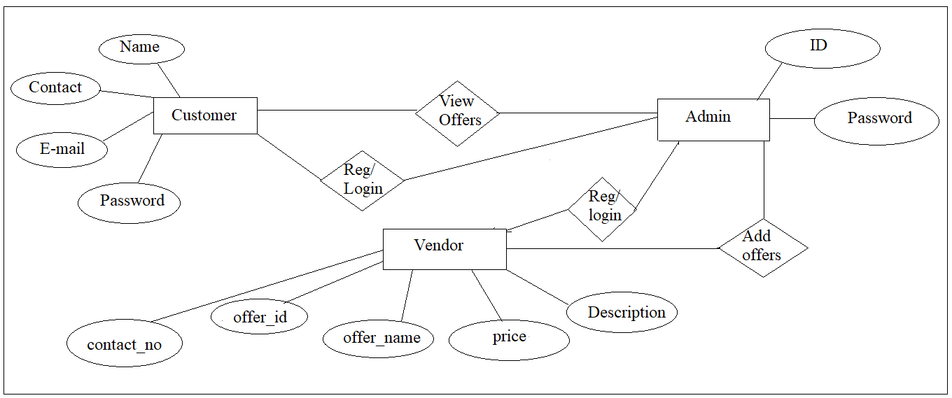
ER DIAGRAM

Slide 14
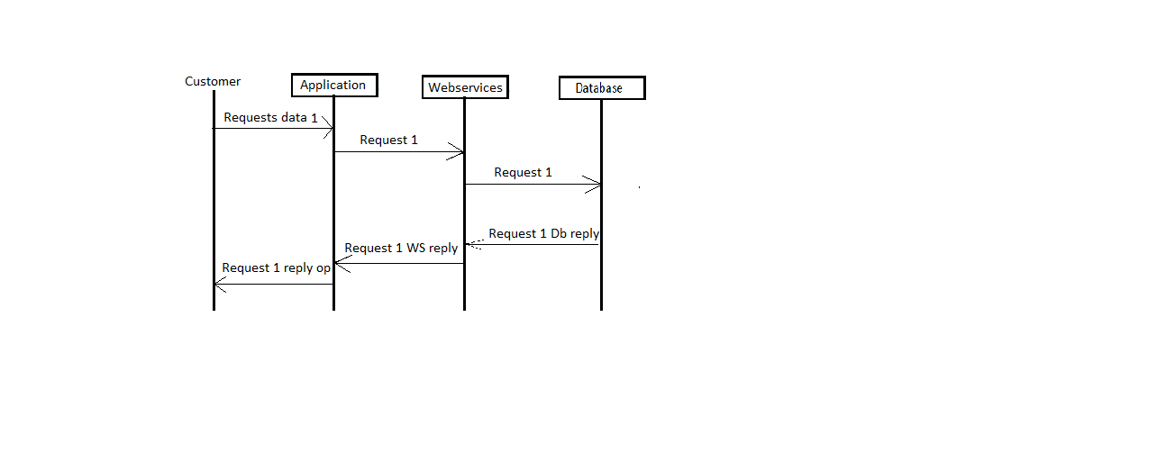
SEQUENCE DIAGRAM
CUSTOMER

Slide 15
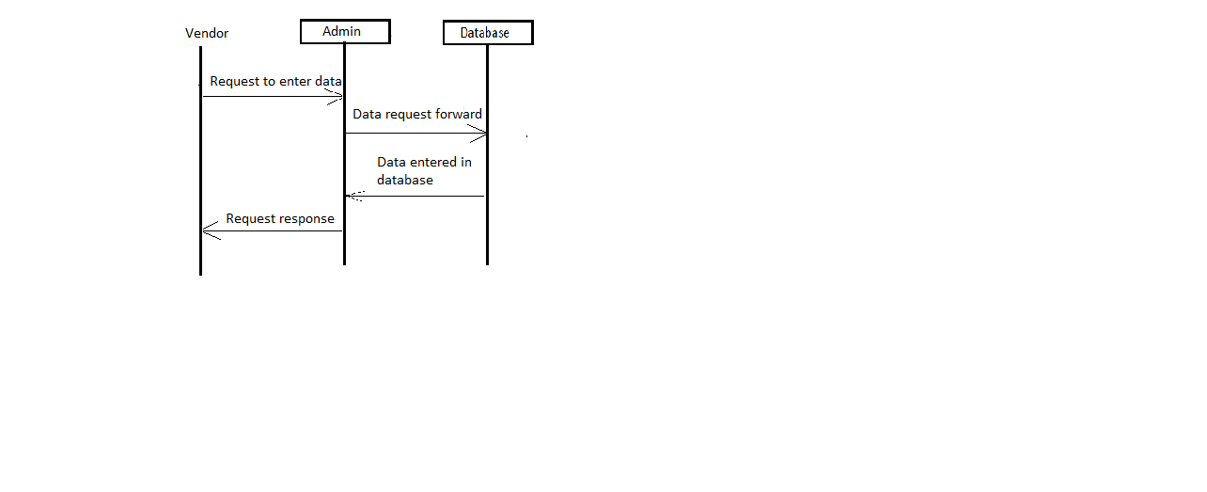
VENDOR

Slide 16
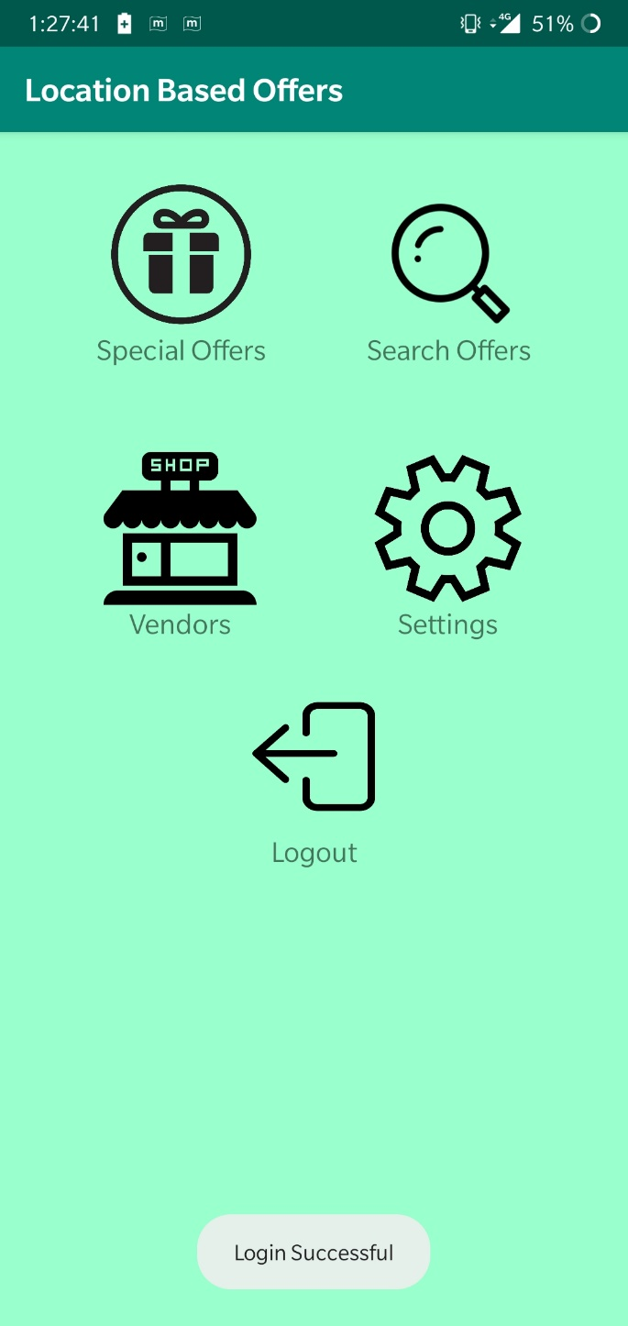
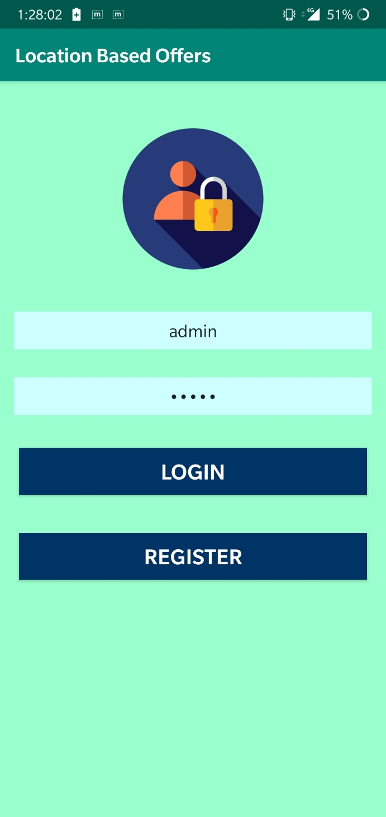

Slide 17
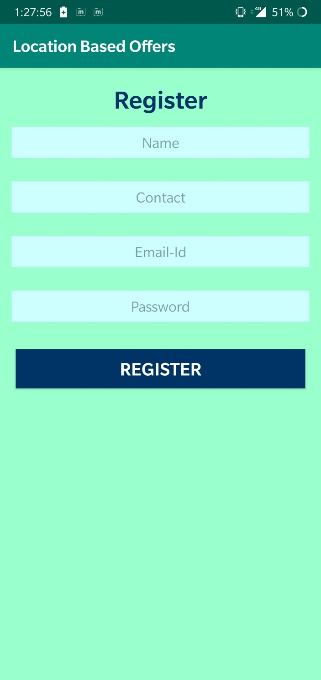

Slide 18
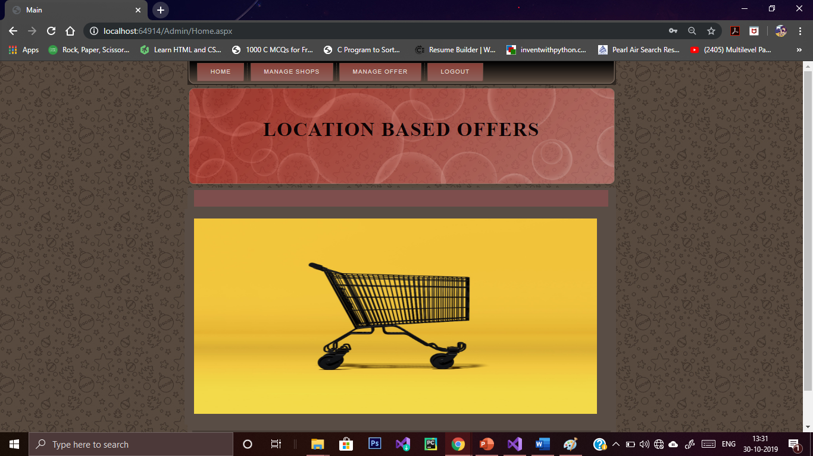

Slide 19
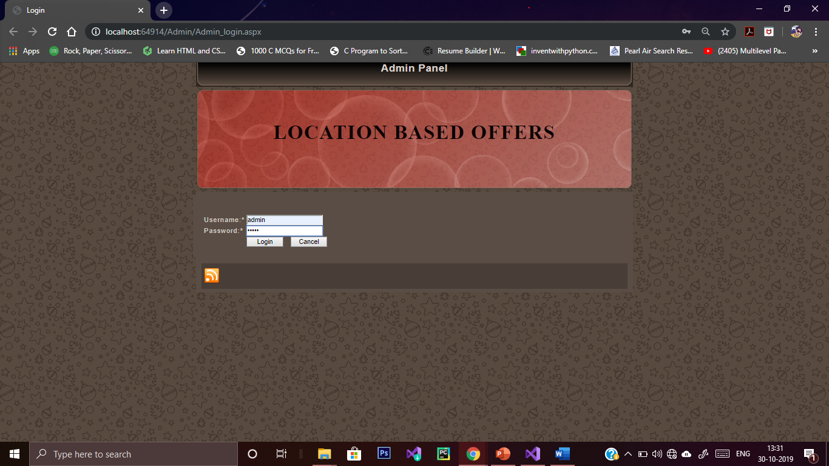

Slide 20
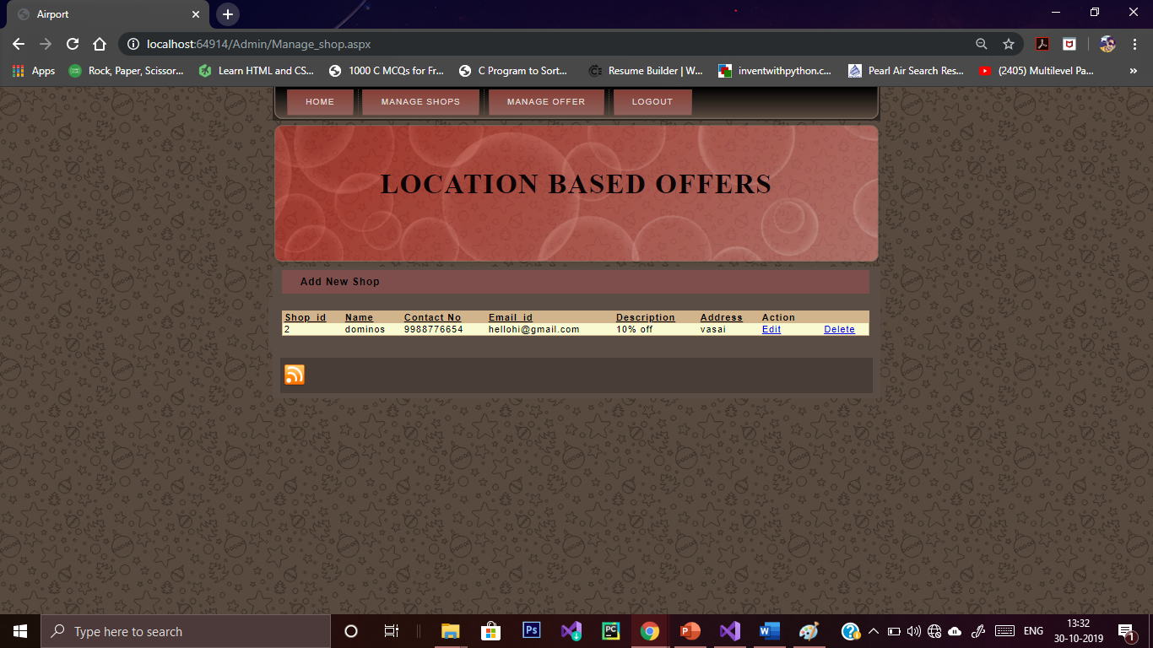

Slide 21
RESULT
This project has helped in developing an android application that works in a real time and makes the life of people easier when they desire to shop or sell their product. This application enables the user tom set the range from where they want to avail the offers. The client can review the product which they purchased on availing the offer and hence, the average of the reviews will be shown to other clients. This helps the clients to filter out the offers of their desire. This app works in both the ways. Vendors can update their offers and location once they get verified and registered by the admin. These functions make the task of users and vendors feasible. It can be used in business purposes on a large scale.

Slide 22
CONCLUSION
Earlier the only use of mobile phone was voice communication, but now voice communication is just one aspect of a mobile phone. There are other major factors such as web browser and GPS services. With the consideration of these factors ‘Grab All’ is implemented. ‘Grab All’ helps to reduce the game between the vendor and the customer by providing the vendors a platform to reach out to all the customers in the nearby area. Also it makes the task of the customer easy, as the customer can easily find out from whom to buy the desired product and who the vendors are and also the vendors location. Hence the business of the local vendors is enhanced and the customer service is made easy.

Slide 23
FUTURE SCOPE
After going through the surveying, it can be gathered that there is a huge scope of application development in our project. Following the same notion, we can also develop application that can tackle following issues of the project:
1) Location positioning technologies
2) Online Payment
3) Expanded Database (For large no. of users)
4) Data Security

Slide 24
REFERENCES
Sandeep Kumar, Mohammed Abdul Qadeer, Archana Gupta Department of Computer Engineering Zakir Hussain College of Engineering and Technology Aligarh Muslim University, Aligarh 202002, India
https://pigeon.srisys.com/blog/types-of-location-based-services
Choong C. Lee Graduate School of Information Yonsei University 50 Yonsei-ro, Seodaemun-gu, Seoul,120-749, Korea
Hongbing Wang, 1, 2, 3 Joshua Zhexue Huang, 3 Yuzhong Qu, 2 Junyuan Xie, 1 1 Department of Computer Science and Technology Nanjing University Nanjing 210093, China
Gartner, G.; Huang, H. Progress in Location-Based Services 2016; Lecture Notes in Geoinformation and Cartography; Springer: Berlin/Heidelberg, Germany, 2017.
CartouCHe, Stefan Steiniger, Moritz Neun, and Alistair Edwardes, "Foundations of Location Based Services," London, UK: SpringerVerlag, 304-307.

Slide 25
Thank You

